Slide 1

Pet Sitter/Dog Walker Online Marketplace Provider Financial Analysis
4/30/2025
Tomoko Seo-Hurtado
Note: This report is exclusively created for author's work sample for job application

Slide 2
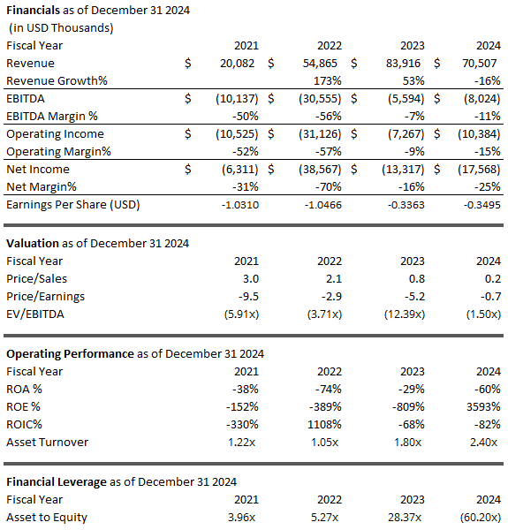
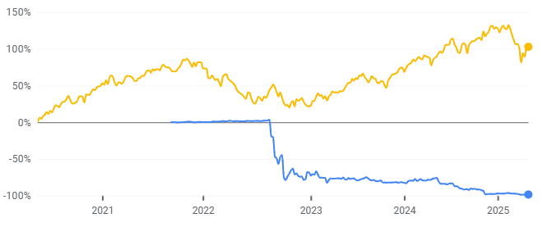
Wag! Financials Overview
<Wag! Overview>
Founded in 2015
IPO in NASDAQ in 2022.
Wag’s total shareholders’ equity went in deficit in Q4 2024
Wag is facing delisting due to market price shortfall
Wag! Stock price
$ 0.15 as of Apr 30
<Financials Overview>
Top revenue declined by 26% in 2024 compared to 2023 although company has been expanding its services
However, profitability ratios have started showing signs of improving
Solvency ratios have been decreasing and the company’s net income is still negative since IPO
(Source: Wag 10-K, Wag website stock information)

Slide 3
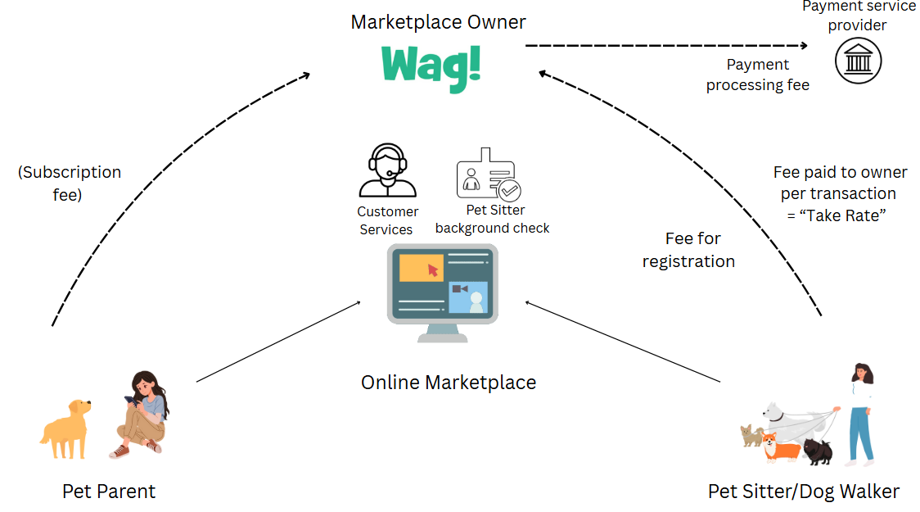
Wag! Business Model
Revenue
Cost
(Source: Wag 2020-2024 10-K, Wag Investor Presentation, Rover 2022 10-K)

Slide 4
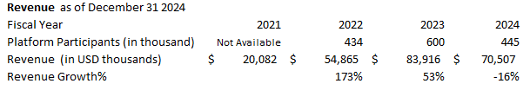
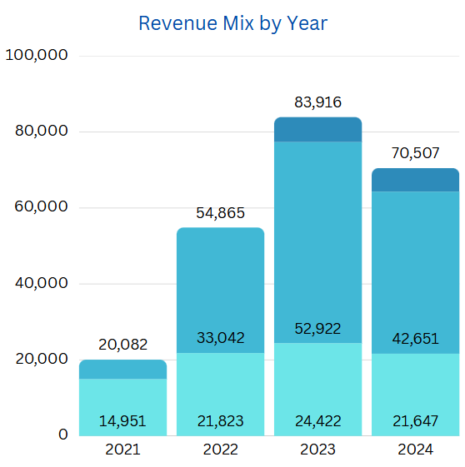
Wag! Revenue
Revenue and Platform participants Declined in 2024 while Revenue per participant Increased by 14%
Revenue mix
Service Revenue : Fees charged by Pet Caregivers, subscription fee paid by Pet Parents, registration fee by Pet Caregivers
Wellness Revenue : Affiliate fees
Pet food & Treats Revenue : Affiliate fees, revenue-per-action or conversion activity
Total revenue declined 16% in 2024 vs 2023 while platform participants decline 26%
However, Revenue per participant increased by 14% in 2024 compared to 2023
Wag has premium subscription which offers users discounts and VIP supports. (System Lock-in)
Wellness revenue is the largest revenue mix (60%) in 2024 followed by services revenue (30%).
Service lines
  Wag!: Online marketplace provider for pet sitter
  Petted: Pet insurance marketplace
  Maxbone: Pet essential
  Dog Food Advisor: Pet food comparison marketplace
  Woofwoof TV: social media brand
  Furscription: Prescription management software
  WeCompare: Pet insurance marketplace
(Source: Wag 10-K, Earing call)

Slide 5
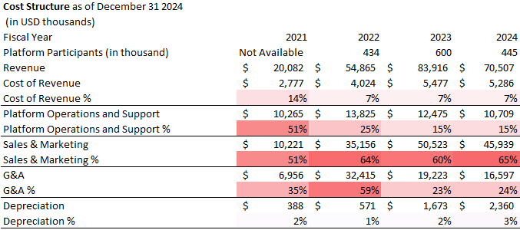
Wag! Cost Structure
In Wag’s Cost Structure, Sales & Marketing expense consists of 60% of revenue
Sales & marketing expense continues to be the largest expense from 2021 to 2024. It averagely consists of 60% of revenue for that last 4 periods.
Cost of Revenue includes 1) background check for Pet Caregivers, 2) payment processor fee, and 3) hosting and platform infrastructure cost
Platform Operations and Supports expense includes technology and operations team’ cost
G&A: 2022 increase was due to stock-based compensation for earnout shares
(Source: Wag 10-K)

Slide 6
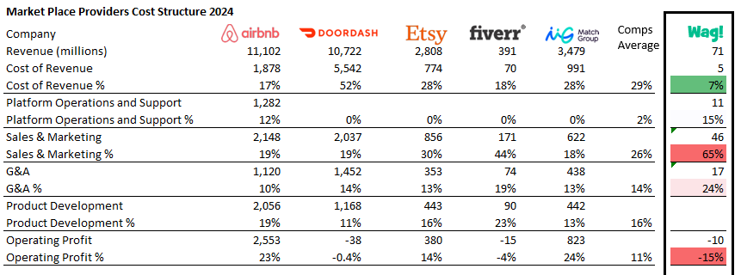
Wag! Cost Structure : Comps
Wag’s Sales & Marketing expense is 250% higher than Comps
Compared to other more matured online marketplace providers listed in Nasdaq (revenue size is 4.5x – 150x) , Wag’s operating profit is still significantly low.
Especially, Wag’s sales & marketing percentage is 250% higher than comps
(Source: Company 10-K)

Slide 7
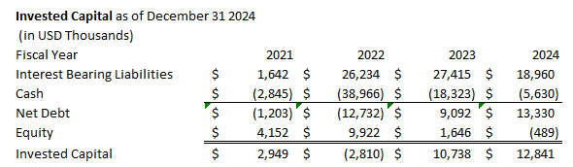
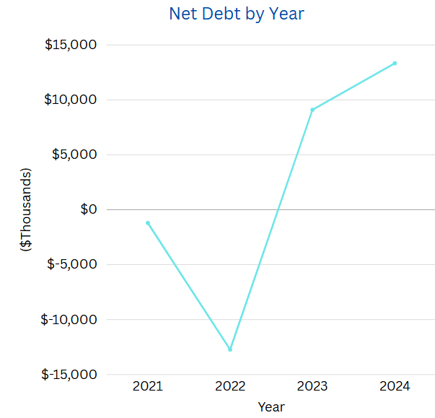

Debt and Equity and Opinion
Wag has solvency risk
Author’s Opinion
Wag is trying to lock in users with premium subscription but the benefit (cross-selling) of lock-in hasn’t exceeded the risk (lost participant) yet
Revenue per platform participant has been increasing however, total revenue amount was declined in 2024 vs 2023
Keep adding attractive contents in the platform are key to boost subscribers and cross-selling
Wag has been succeeding in optimizing expense except sales & marketing over the years.
2024: Due to operating net loss, net debt reached 13 million and Wag’s equity went into deficit in 2024
Wag has solvency risks and tackling financing issues is immediate priority
2022: Wag entered into a credit agreement with Blue Torch Capital (private credit) that provides up to $32 million of credit
(Source: Wag 10-K)

