Slide 1
U.S. Pet Sitter/Dog Walker
Market Research Report
4/30/2025
Tomoko Seo-Hurtado
Note: This report is exclusively created for author's work sample for job application

Slide 2




Executive Summary
Market Size/Outlook
Strategies observed in the Market
2024 U.S. Pet Service (Other) * Market Size is $13.0Bn
New market development with concentration on Pet sitter marketplace
* services includes pet sitting/dog walking, training and grooming etc.
To grow at a CAGR of 6.2% from 2021 to 2025
Product portfolio expansion (cross-selling) within the existing market
External environments shows positive signs
System Lock-In with subscription
Competitive Landscape
Social Trend: Humanization of Pets
U.S. Pet sitter/Dog walker market is highly fragmented
Pet parents are willing to buy services and experience for their pets that were once considered for human
  Nannies
  Personalized nutrition
  Medical treatment such as regular dental checks
  Luxury items
Players are:
Online Marketplace
Offline Competitors (family, friends)
Onsite Daycare/Boarding Facilities
Adjacent Marketplace entering Pet sitter services

Slide 3
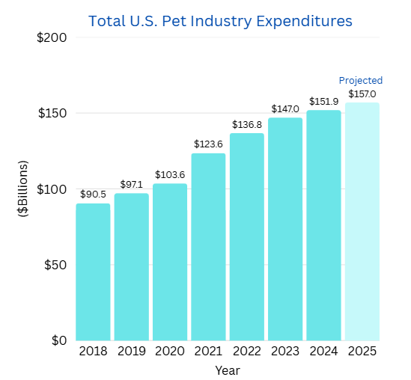
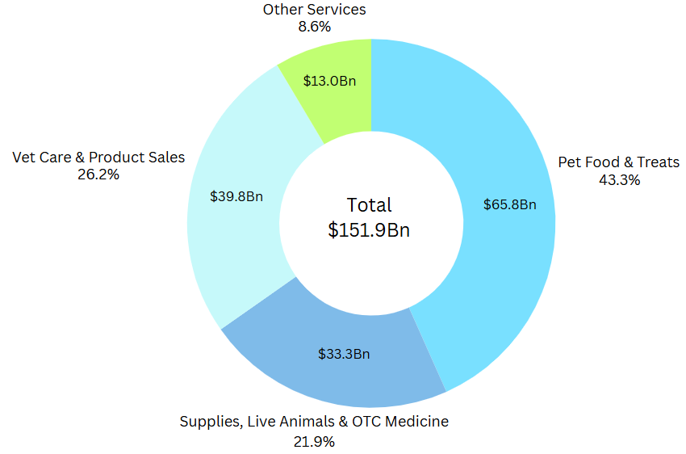
U.S. Pet Industry Market Size
U.S. Pet Industry Market has been growing at a CAGR of 6.2% from 2021 to 2025
U.S. Pet Industry market is expected to grow at a CAGR of 6.2% from 2021 to 2025
U.S. 2024 other services* expenditure was $13.0Bn
* services includes pet sitting/dog walking, training and grooming etc.
CAGR + 6.2%
(Source: American Pet Products Association “Industry Trends and Stats”)
(Source: American Pet Products Association “Industry Trends and Stats”)

Slide 4
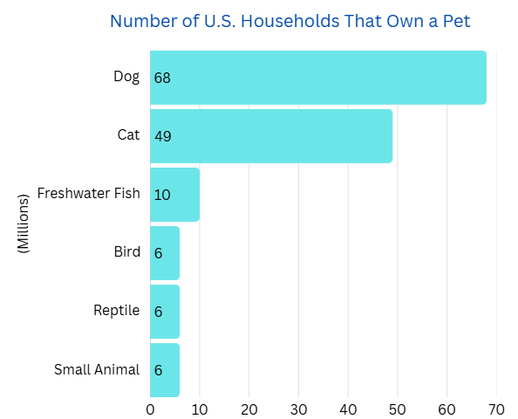
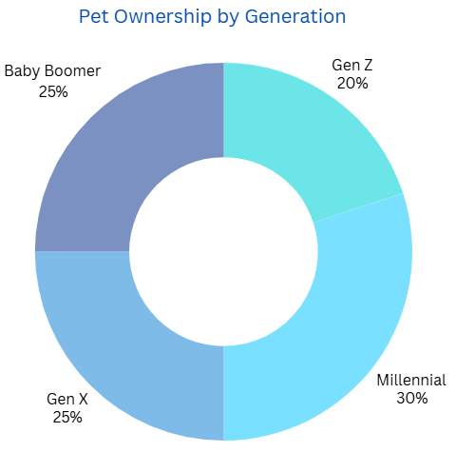
U.S. Pet and Owner Demographics
Most popular pets in the US are dogs and cats
2025 American Pet Product Association Survey says 94 million U.S. households own a pet
Dogs are the most popular pets, followed by cats
Millennials make up the largest percentage of current pet owners
(Source: American Pet Products Association “Industry Trends and Stats”)
(Source: American Pet Products Association “Industry Trends and Stats”)

Slide 5



U.S. Pet Business External Environments
External environments shows positive signs to support market growth
Category | Theme | Trend | Impact to Pet Business | Comments
Political | Regulation | Increasing |  | States are seeking to regulate groomers, trainers, kennels and boarding establishments. Some municipalities requires dog walker obtain permits.
 | Government Support | Steady |  | There is no major government support specifically for this industry. Pet Sitters International (PSI) is trade association for pet sitters.
Economic | Unemployment rate | Steady |  | U.S. GDP expected to be downward toward 2025 and 2026. U.S. unemployment expected to stay around 4.1%-4.3 from 2025-2028
 | No. of Pet No. of households | Increasing |  | 66% of U.S. households (86.9 million homes) own a pet in 2024 compared to 56% of U.S. households owns a pet in 1988 Number of U.S. households has been increasing at 4% per decade.
 | Work from home | Decreasing |  | Average weekly telework hours were 27.2 hours in 2024 Q1 and it was declined about 7% from 29.3 hours in 2023Q1
Social | Humanization of pets | Increasing |  | Pet parents are willing to buy services and experience for their pets that were once considered for human.
Technological | New technology | Increasing |  | Telemedicine, AI Smart Pet Products, Pet business management software
Legal | Liability Insurance | Steady |  | No specific item.
(Source: BCG, American Pet Product Association, FRB Philadelphia, Forbes, U.S. census Bureau, U.S. Bureau of Labor Statistics)

Slide 6





Pet Sitter/Dog Walker Competitors Landscape
U.S. Pet sitter/walker is highly fragmented and low entry barrier
Category | Pet Sitter/Dog Walker |  |  |  |  | Adjacent Service entering Pet Sitter
 | Online Marketplace |  | Off-line | Franchisor |  | Online Marketplace
Company | Rover | Wag | Family, Individual | Fetch! Pet Care Private | Camp Bow Wow | Care.Com | Meowtel | Sittercity
Founded | 2011 | 2015 |  | 2002 |  | 2006 | 2015 | 2001
HQ | Seattle, WA | San Francisco, CA |  | Dayton, OH |  | Austin, TX | Dover, DE | Chicago, IL
Region | US, Canda, UK, Europe | US |  | US | US, Canada | US | US | US
Employee | 501 (2022) | 64 | N/A | 50 | N/A | 2,376 | 25 | 790
Revenue Model | Marketplace transaction Fee | Marketplace transaction fee Subscription | Free/Fee for Service | Franchise Fee | Fee for Service | Subscription fee | Marketplace transaction fee | Marketplace transaction fee
Services | Petsitter/Pet owner connecting marketplace provider | Petsitter/Pet owner connecting marketplace provider |  | Franchisor of Petsitter, Pet Taxi, Pet Medical | Daycare, boarding, training, grooming | Caregiver/Families marketplace provider (baby, senior, pet, housecleaning) | Catsitter/Cat owner connecting marketplace | Caregiver/Families marketplace provider (baby, pet)
Strategy | Market expansion to other countries | Wider product portfolio (cross-selling) System lock-in by subscription |  | Market penetration (more locations) | Market penetration
Ownership | Private, PE backed | Public |  | Private | Private | Private, Public Parent | Private, VC backed | Private, Public Parent
(Source: Company investor presentation, Company 10-K, Company Website)

Slide 7


Social trend: Humanization of Pets
BCG suggests fruitful growth areas in the Pet business reflects humanization of pets
BCG says the most fruitful areas for growth reflects the humanization of pets.
In BCG survey, 80% of pet owners consider their pets are a vital member of their family
Pet owners are more willing to spend money on their furry friends for the following areas.
  High-quality and more premium pet food: high single digits until 2029 in North America
  Supplements: 10% growth each year for dogs, and 12% each year for cats until 2028. This growth is also fueled by the increased life expectancy of pets
  Concierge services such as nannies, home care, and personalized nutrition.
  Medical treatment: more closely mirror what is available for human such as regular dental checks.
BCG say the followings areas are the ones brands and investors should consider for growth:
  Ease of Living : enriched daycare and boarding experiences. knowing whether restaurants have a doggy seating area. vacations are pet friendly
  Technological Advances : connected and wearable devices for pets aimed at improving wellbeing. dog
  fitness trackers, or apps to monitor health, mood, or
  optimal nutrition
  Luxury Offerings : pet fragrances, designer accessories, or wellness spas for four-legged guests
(Source: BCG, “Pet Owners Are Changing. How Will the Industry Respond?” March 04, 2025)

